Slide 1


Software Quality Engineering (Week-3)
Usama Musharaf
LECTURER (Department of Computer Science)
FAST-NUCES Peshawar

Slide 2
Content of Week # 3
Quality Attributes
Software Quality Models
System Performance

Slide 3

Quality attributes
Quality attributes depend on each other.
It is impossible to completely satisfy all quality attributes of a software system.

Slide 4
SOFTWARE QUALITY MODELS
Quality is the excellence of the product or service.
From a user’s point of view, quality is ‘fitness for purpose’.
From the manufacturing point of view, the quality of a product is the conformance to specification.

Slide 5
Hierarchical models
McCall divided software quality attributes into 3 groups.
Each group represents the quality with respect to one aspect of the software system while the attributes in the group contribute to that aspect.
Each quality attribute is defined by a question so that the quality of the software system can be assessed by answering the question.

Slide 6
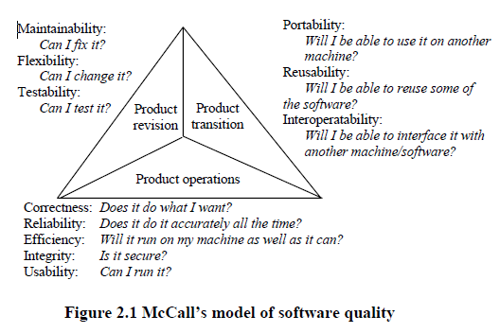

Slide 7
Relational models
Perry’s model contains three types of relationship between the quality attributes.
The direct relationship
The inverse relationship
The neutral relationship

Slide 8
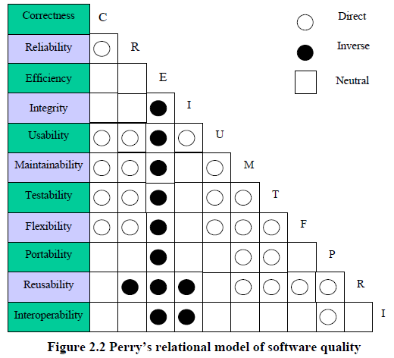

Slide 9
Relationship b/w quality attributes
Integrity vs. efficiency (inverse):
The control of data access will need additional code, leading to a longer runtime and more storage requirement.
Usability vs. efficiency (inverse):
Improvement of HCI will need more code and data, hence the system will be less efficient.

Slide 10
Relationship b/w quality attributes
Maintainability and testability vs. efficiency (inverse):
Compact and optimized code is not easy to maintain and test.
Flexibility, reusability vs. integrity (inverse):
Flexible data structures required for flexible and reusable software increase the data security problem.
Reusability vs. maintainability (direct):

Slide 11
Relationship b/w quality attributes
Portability vs. reusability (direct):
Portable code is likely to be easily used in other environments. The code is likely well-structured and easier to be reused.
Correctness vs. efficiency (neutral):
The correctness of code has no relation with its efficiency. Correct code may be efficient or inefficient in operation.

Slide 12
Software Quality Engineering Road Map
Quality Engineering at every SDLC phase:
Quality Engineering
Requirement Analysis
Quality Attributes
Design
Version Controlling
GIT, GIT Hub
Code
Unit Testing
(Junit)
Testing
Docker Containers
Defects
Deployment

Slide 13
Quality Engineering at Design/Architecture Phase
Performance
Scalability
Reliability
Security

Slide 14
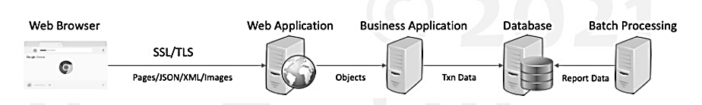
Sample System

Slide 15
Performance

Slide 16
Performance
Measure of how fast or responsive a system is under
A given workload
Backend data
Request Volume
A given hardware
Kind
capacity

Slide 17
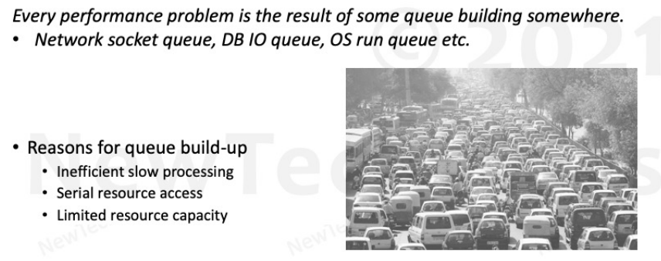
Performance Problems
How to spot a performance problem? How does it look like?

Slide 18
Performance Principles
Efficiency
Efficient Resource Utilization
IO- Network, Memory, Disk
CPU
Efficient Logic
Algorithms
DB Queries
Efficient Data Storage
Data Structures
DB Schema
Caching
Concurrency
Hardware
Software
Queuing
Coherence
Capacity

Slide 19
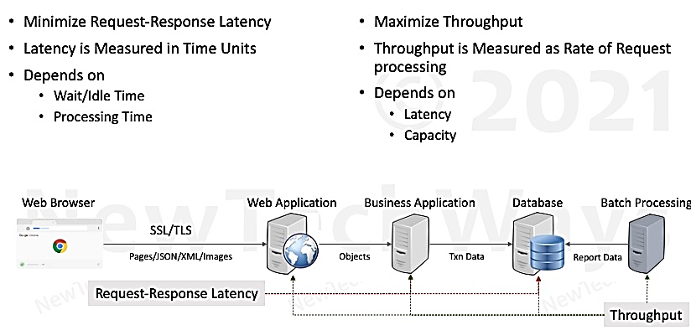
Performance Objectives

Slide 20
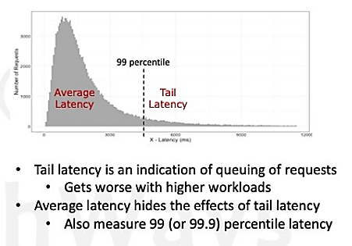
Performance Measurement Metrics
Latency
Affects– User Experience
Desired– As low as possible
Throughput
Affects– Number of users that can be supported
Desired– Greater than the request rate
Errors
Affects– Functional Correctness
Desired– None
Resource Saturation
Affects– Hardware Capacity Required
Desired– Efficient utilization of all system resources.

Slide 21
Serial Request Latency

Slide 22
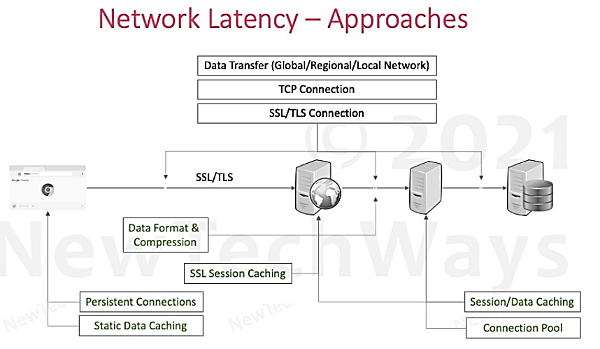

Slide 23
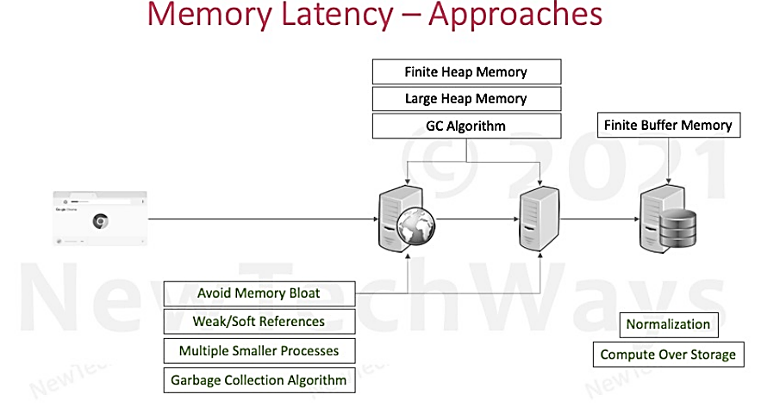

Slide 24
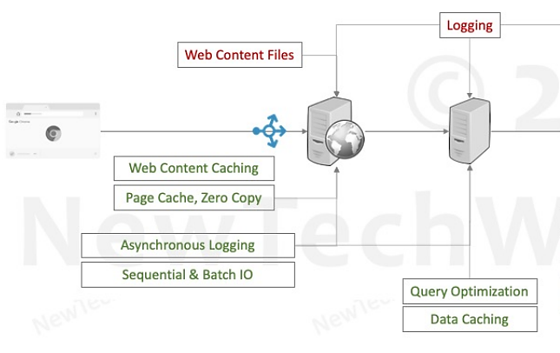
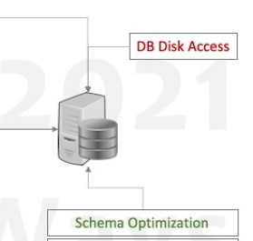

Disk Latency - Approaches

Slide 25
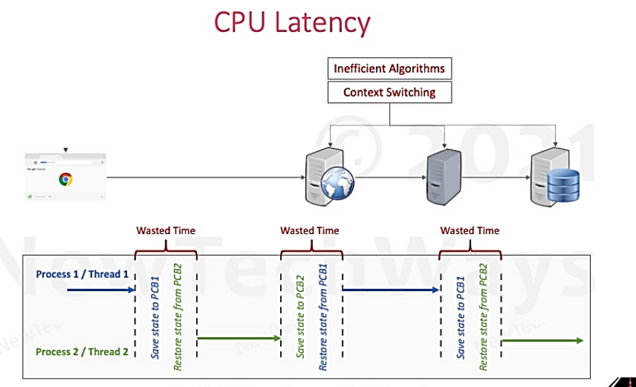

Slide 26
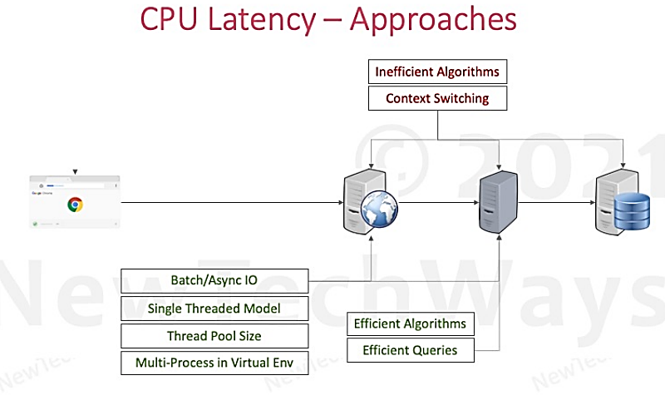

Slide 27
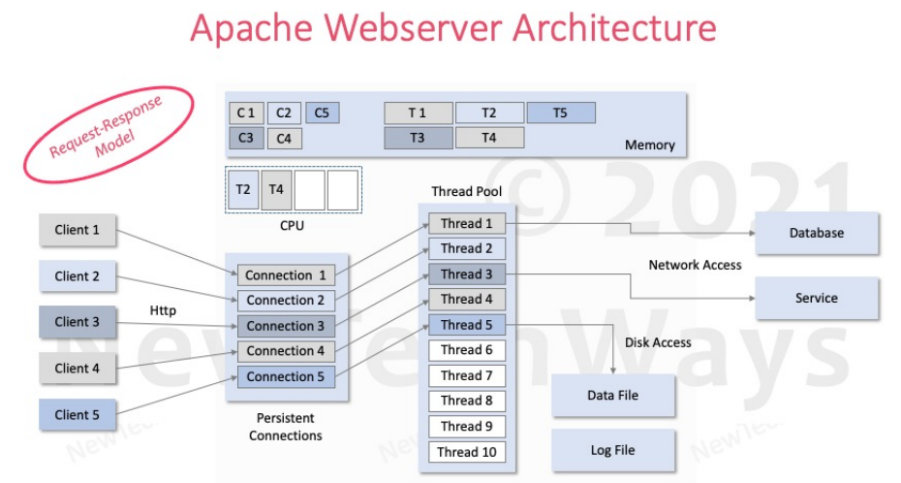

Slide 28
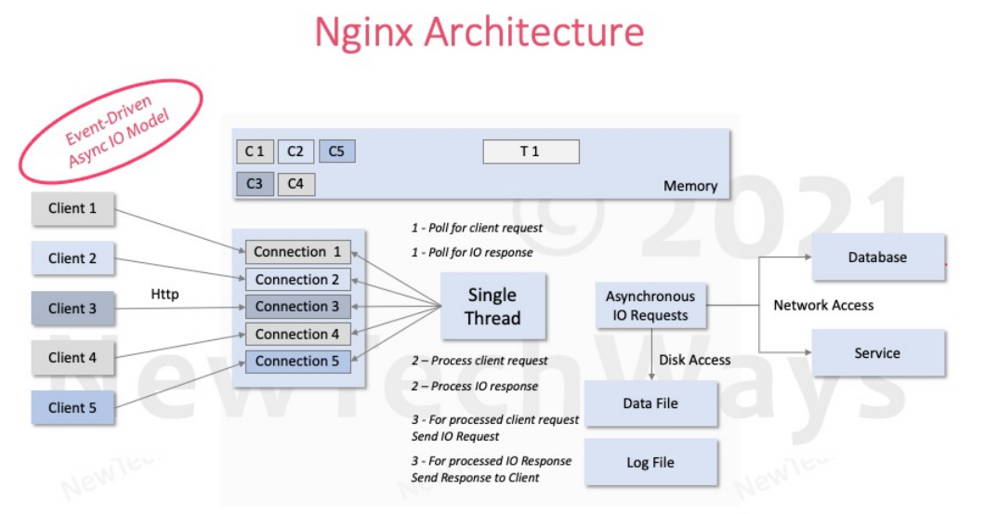

Slide 29
Parallel Request (Concurrency)

Slide 30
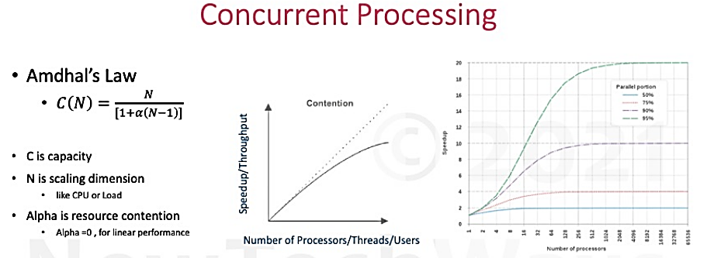
C(N) = theoretical speed
Parallel + Serial

Slide 31
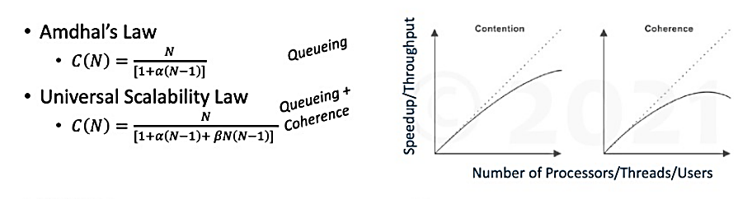
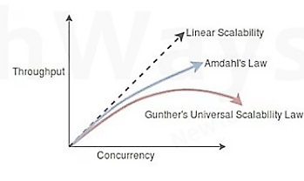
Concurrent Processing
C is capacity
N is scaling dimension like CPU or load
Alpha represents resource contention
Beta represents coherence delay
Linear performance when alpha and beta are zero

Slide 32
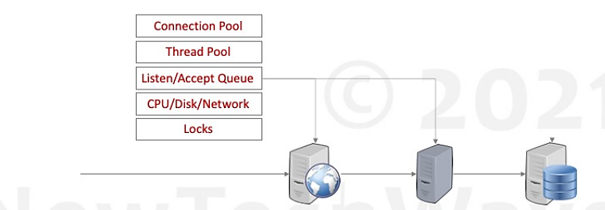

Contention

Slide 33
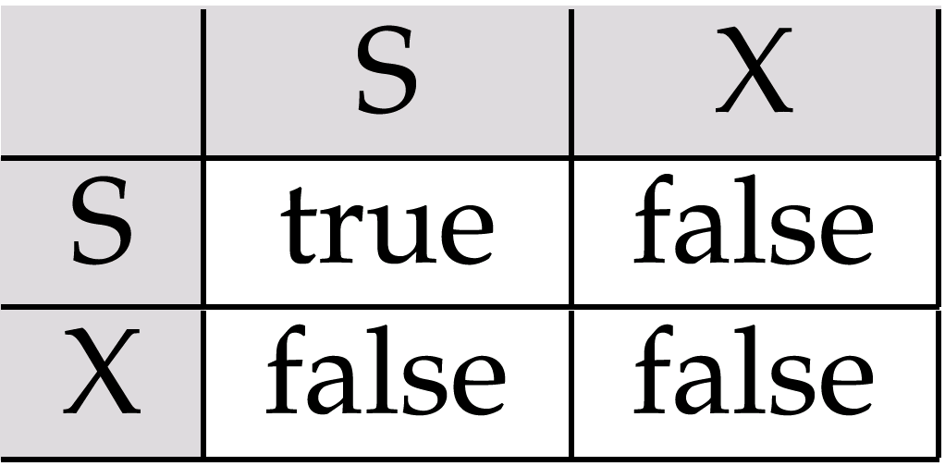
Locking Compatibility Matrix

Slide 34
Coherence
Suppose that two threads are working on SharedObj. If two threads run on different processors each thread may have its own local copy of sharedVariable.
If one thread modifies its value the change might not reflect in the original one in the main memory instantly. This depends on the write policy of cache. Now the other thread is not aware of the modified value which leads to data inconsistency.
“Volatile” keyword in java tells the compiler that the value of a variable must never be cached as its value may change outside of the scope of the program itself.

Slide 35
HAVE A GOOD DAY !

